Slide 1
CpE 213
Chapter 2
8051 Hardware

Slide 2
8051 Family
8051 introduced in 1980 by Intel
Second sourced by many vendors
Competition from Motorola (6811) and Microchip (PIC)
No such thing as ‘8051’
  S87C751-1N24: OTP, 0-70°C, 24 pin PDIP
  P89C51RD2BA: 64k Flash, 1k Ram, PLCC
  See selection guide or ordering info for details

Slide 3
Generic 8051 Features
0-64kB internal code ROM, Eprom, Flash
64-256 bytes internal data RAM
Four 8-bit I/O ports: P0, P1, P2, P3
1 to 3 16-bit counter/timers
Bit addressable registers
Serial interface
64k external code and data address space
12 Mhz clock, 1 μsec cycle time

Slide 4
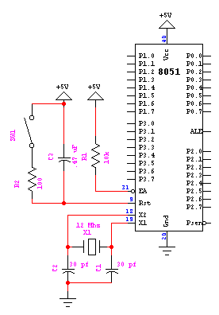
A simple 8051 design
40 pin DIP package
manual and power on Rst
Internal ROM and RAM

Slide 5
Port 1
Port 0
Port 3
Port 2
ALE and Psen used for
memory expansion

Slide 6
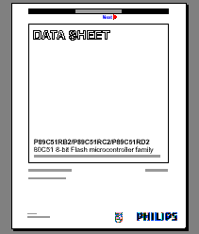
8051 Data Sheet
Main source of microcontroller info
Available in pdf at vendors’ websites
Selected datasheets on local CpE213 website
Also in Appendix D
Additional info in hdwr,pgmr,arch man

Slide 7
89C51Rx2 data sheet
Features, Ordering Info, Packaging
Block diagram,
Logic diagram
Pinouts [note different packages]
Pin descriptions [summary of pin functions]
Alternate functions for Port 3
Oscillator characteristics: note Fig 2-3 difference
DC characteristics

Slide 8
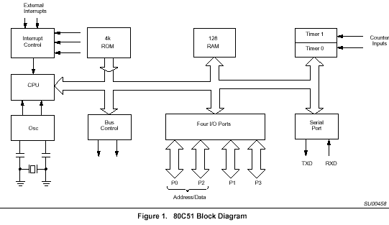
FamArch.pdf [block diagram]

Slide 9
8051 I/O ports
P0 only has a pulldown fet, no pullup.
SETB P0.0 writes a ‘1’ to P0 bit 0
‘1’ turns off fet pulldown
read-modify-write reads latch, others read pin value
Internal Data Bus
RdPin
RdLat
D
Q
P0<=

Slide 10
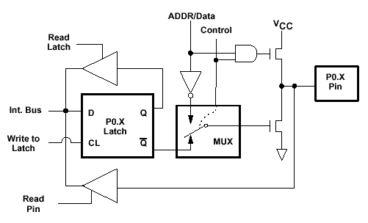
More Port 0 (sfr 80h)
Port 0 has active pullup that is turned off when Control=0 (shown)
True bi-directional when Control = 1
Fig 4a from Hdwr guide
Notes:
Port 0 is a true bi-directional port for use as address/data bus. If EA=0 then the 8051 is in expansion mode and P0 is used as the multiplexed address data bus. You can read and write the latch but it has no effect on the pin. It’s not quite clear in this simplified diagram but both fets can be turned off, thus tri-stating the pin. This is the state when memory is being read (opcode fetch or data RD operation).

Slide 11
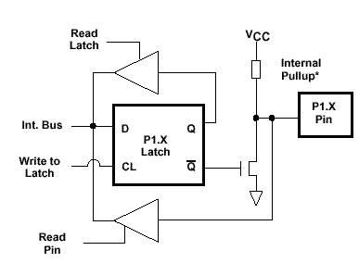
Port 1 bits (sfr 90h)
Port 1 has active pulldown and passive pullup
Must write a 1 to P1 to use as an inport

Slide 12
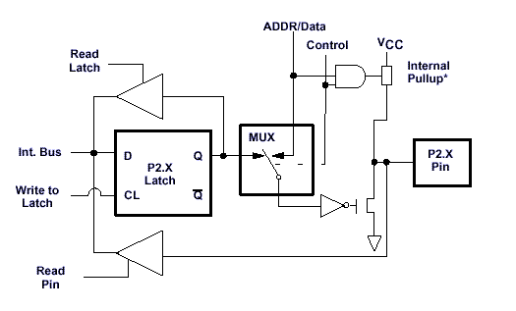
Port 2 bits (sfr 0A0h)
P2 does double duty as A(15 downto 8)
If Control=0, P2 is I/O port with passive pullup
Must write a ‘1’ to act as input port
If Control=1 then address buffer with active pullup

Slide 13
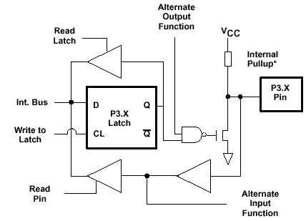
Port 3 bits (sfr 0B0h)
Also does double duty
  eg P3.6 is also WR_n
  P3.4 is T0 input

Slide 14
8051 I/O ports
Four I/O ports: 80h, 90h, A0h, B0h
  SFR addresses: 10xx0000, xx=00,01,10,11
P0 has active pulldown, no pullup
  P1, P2, P3 have passive pullup (about 100kΩ)
Must write a ‘1’ to be used as input

Slide 15
8051 memory organization
Multiple memory spaces
code, data, xdata, bit
Example: 4 location 0’s!
  mov a, 0 ; load acc with data loc 0 (R0)
  mov c, 0 ; load cy bit with bit loc 0
  movc a,@dptr ; dptr=0, load code loc 0
  movx a,@dptr ; load xdata loc 0 (if exists)

Slide 16
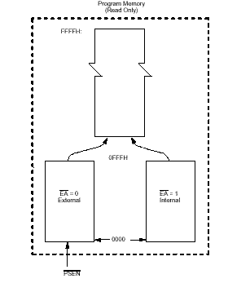
Program (code) memory
EA=1: internal; EA=0: external
PSEN used to select external code rom
Internal rom range: 0000 to 0FFFh
  more or less depending on chip

Slide 17
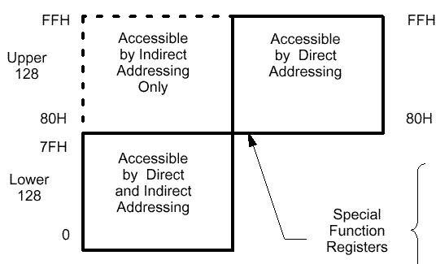
Internal RAM
128 bytes of ram: direct or indirect address
  mov a, 0 or mov a,@R0
128 byte sfr address space: direct only
  mov a,80h
8052 has extra 128 bytes: indirect only
  mov R0,#80
  mov a,@R0

Slide 18
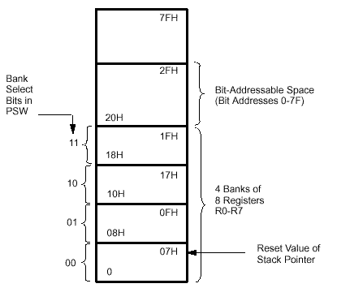
Internal RAM
Low 128 bytes contains:
  Four banks of 8 registers (R0 through R7)
    PSW(4:3) selects: mov psw,#18h ;use Bank 3
  16x8 bits of bit addressable ram
    cpl 0 is same as xrl 20h,#1

Slide 19
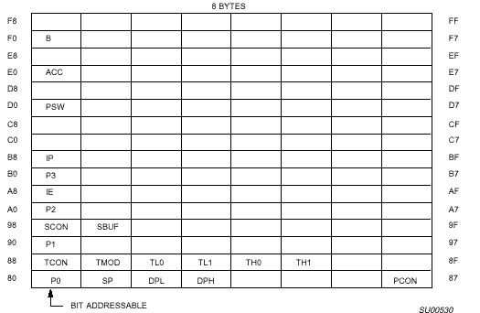
Special Function Regs
MOV E0,#55 is same as MOV A,#55 but takes one more byte
Only addresses in range 1xxx x000 are bit addressable
Some SFR’s are data regs (dpl,dph) and some are peripheral regs (P1, TH0, TH1)

Slide 20
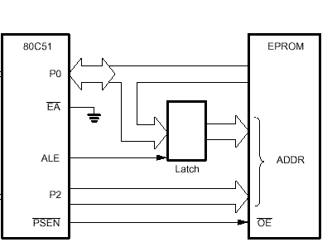
External code memory

Slide 21
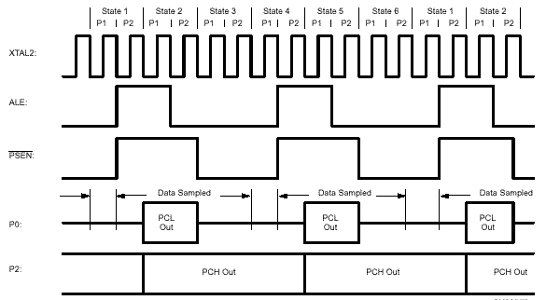
Instruction Fetch Timing
Address valid here
Data valid here
Notes:
Note 2 ALE’s per 12 clock cycles or 2 ALE’s per instruction cycle
An instruction byte is read every 6 clock cycles. this constitutes a bus cycle.
Some bus cycles are wasted and the instruction byte is read again.
PSEN is used to enable reading from external rom
PSEN is active low while ALE is active high
A 74hc373 transparent latch can be used for the latch (see p 210 of ISM)
A PLD or FPGA is often used in new designsto reduce the number of glue logic packages.

Slide 22
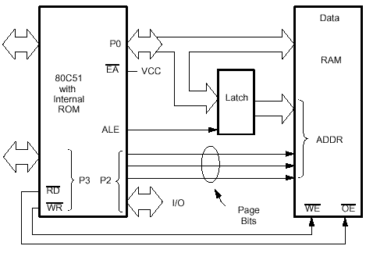
External Data memory
Notes:
This figure is from the family architecture manual (page 3 fig 5).
Address bits from the latch and P2 are used to select the ram, RD (P3.7) is used to enable the ram output drivers during data read, WR (P3.6) is used to enable writing into the ram during data write. P0 is driven by the 8051 during writes and address cycles, and by the ram during read cycles.
All of the bits of P2 are used during DPTR accesses (movx a,@dptr). If R0 or R1 is used in a movx then P2 may be used under program control to select external data devices (ram or I/O): movx a,@R0.
RD is similar to PSEN during read bus cycles.
WR and RD timing is similar. Both are a bit longer than PSEN cycles and cause an ALE cycle to be skipped.

Slide 23
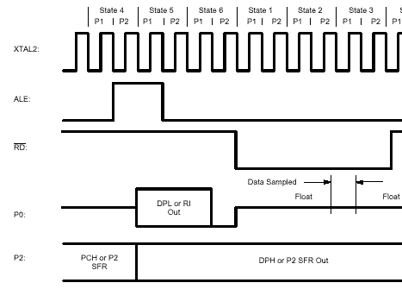
External Data (read or write)
Notes:
Note the missing second ALE cycle during the RD (or WR) cycle.
Question: Does RD (WR) always occur after a state 4 ALE cycle or can it occur after a state 1 ALE cycle?

